Slide 1
Wearable technology

Slide 2
Introduction
Always present, always working collection of personal applications.
These applications are mobile, persistent, aware of the user's goals and context, and function even when the user is directing her attention elsewhere.
Characteristics
Mobile
Persistent
Proactive (Semi-autonomous. Wearable applications are capable of taking action to get the user's attention.)
Context Aware
Secondary or Tertiary Task (Help but not distract)

Slide 3
Advantages
Augmentation – Enhances user’s information
Privacy - Context awareness requires knowledge of context, which is gained through sensing and interpreting data from the wearer and the wearer's environment.
Consolidation - Consolidating applications into an integrated context-aware environment allows for the elimination of redundant batteries, wireless network interfaces, packaging, etc. More importantly, it allows a top-level attention manager to broker all of these applications to make the best possible use of the wearer's personal bandwidth.
Trust and Transparency
Context-Awareness is the key

Slide 4
Uses of Wearable Technology
Healthcare
Diet Management
Police and Security
Traffic Management
Car Insurance
Personal Navigation
Arranging Meetings

Slide 5
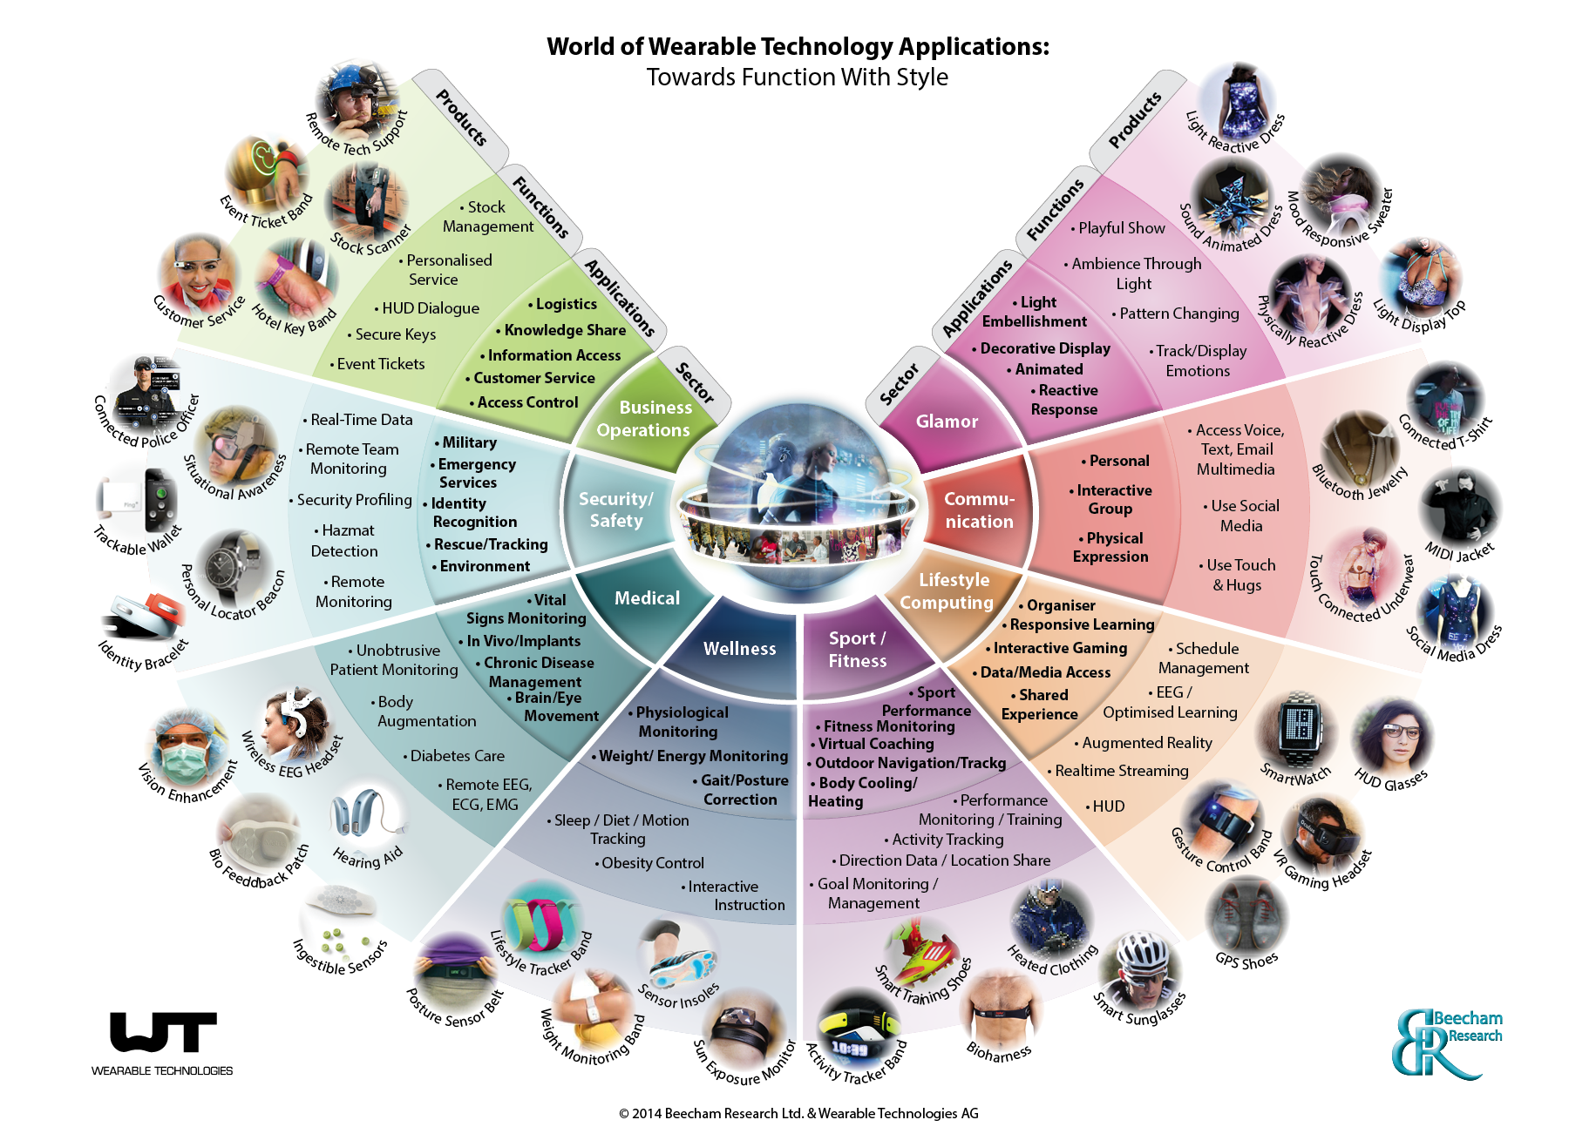

Slide 6
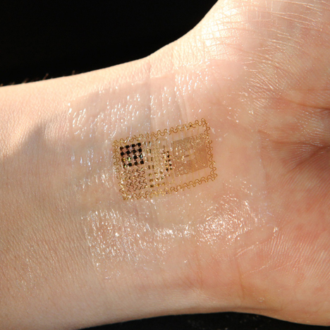

Slide 7
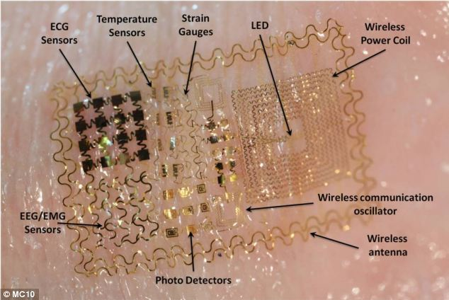
MC10 – Bio Stamp

Slide 8
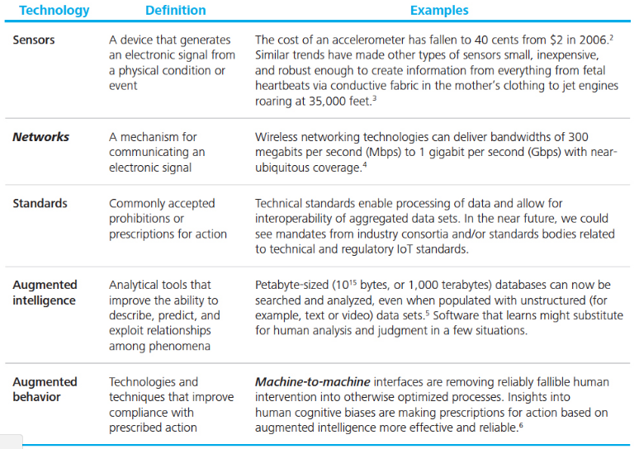
Technologies required for Wearable Technology

